Slide 1
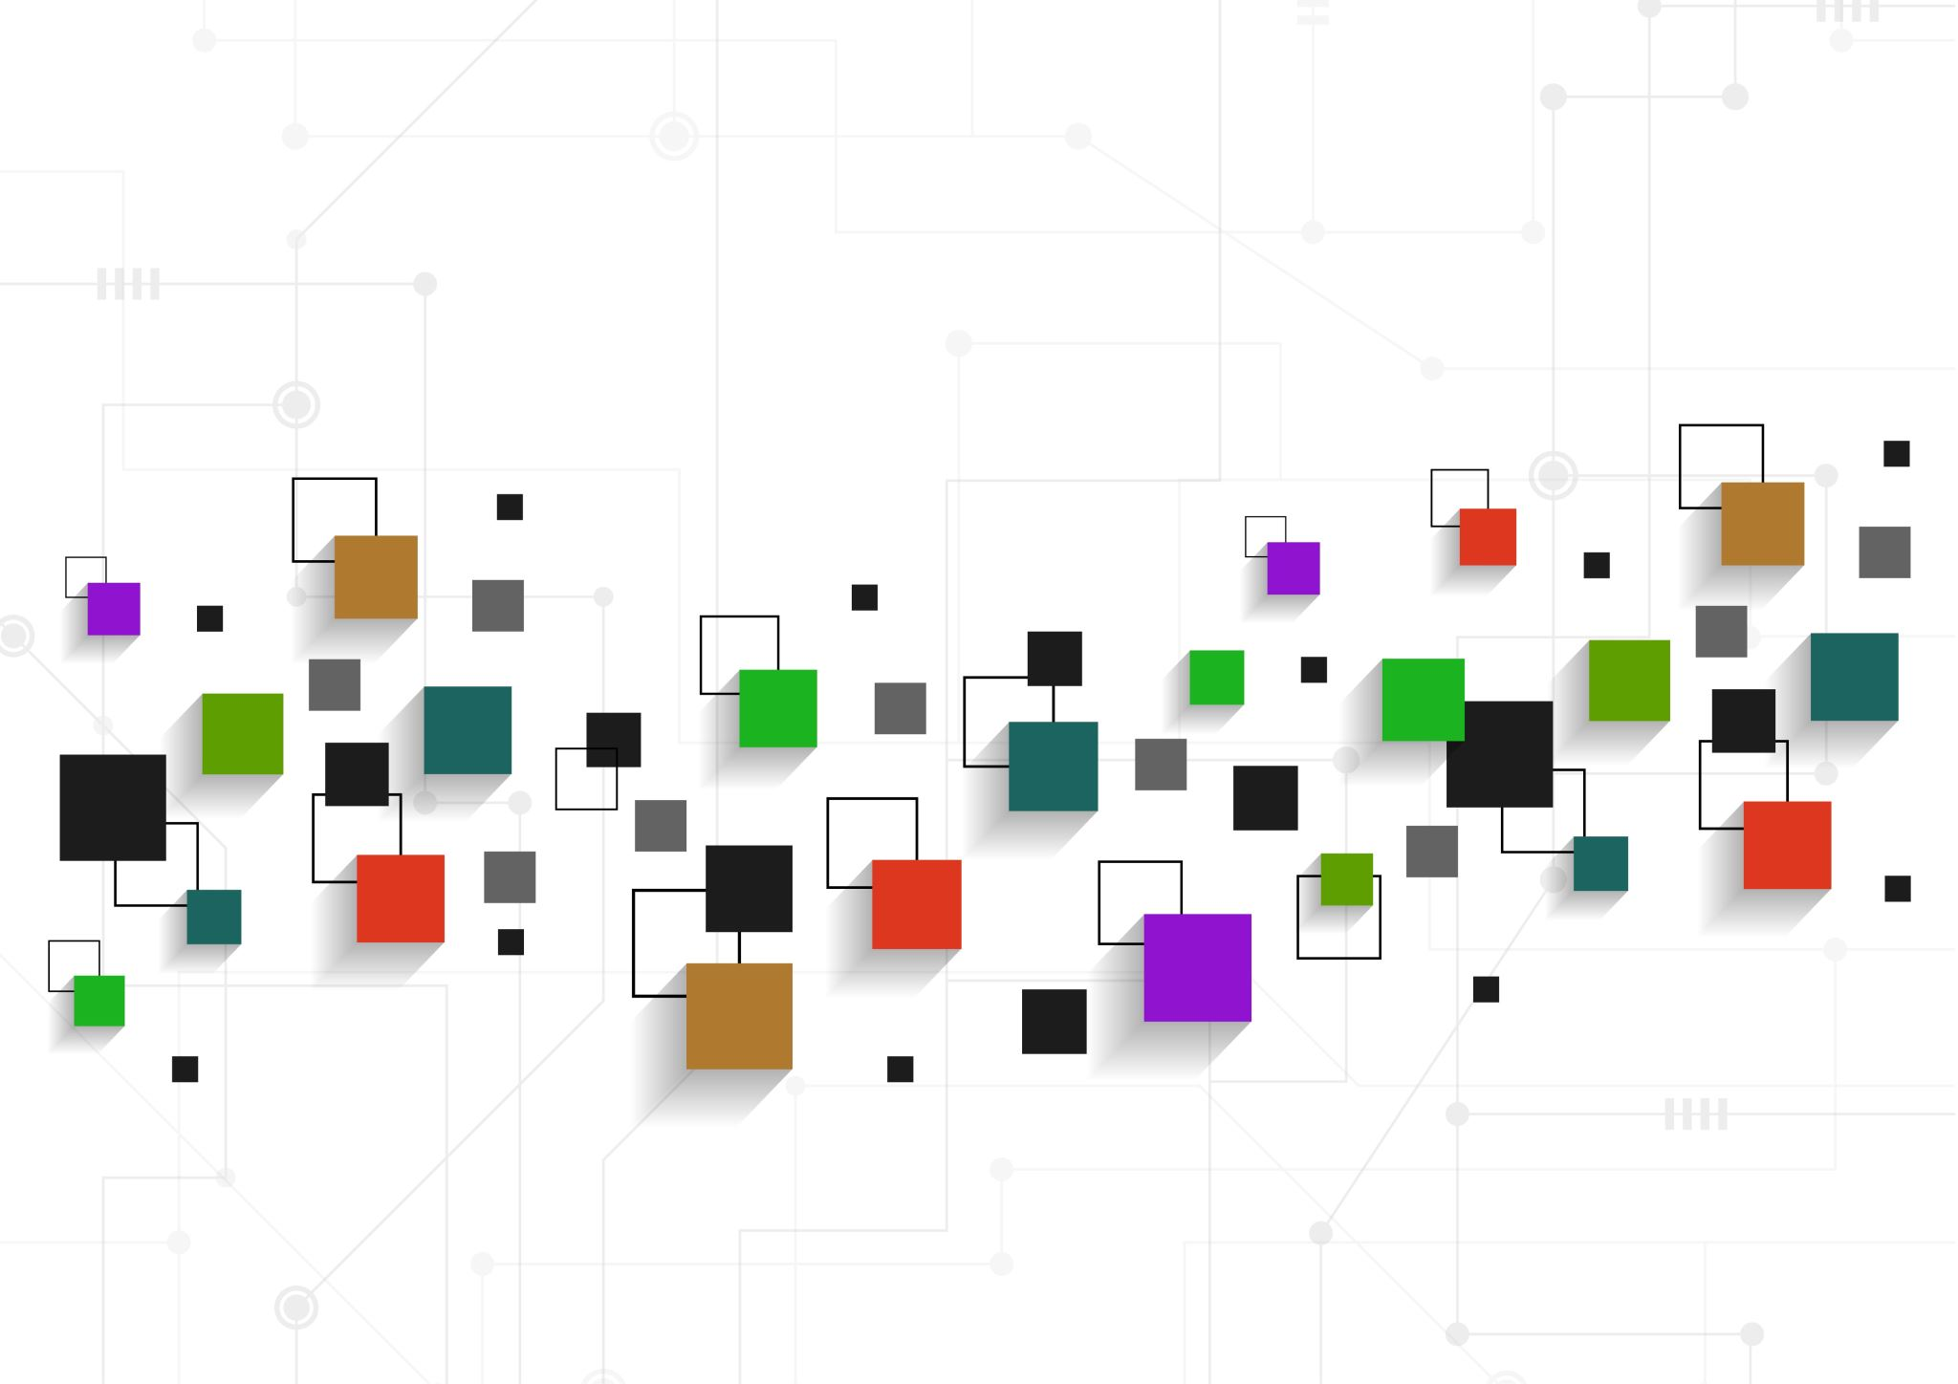

Infrastructure based and Infrastructure less Network
Monika M – 20BIS025

Slide 2
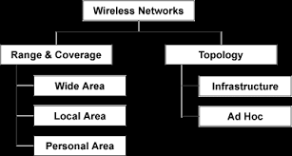
Wireless Network
A wireless network allows devices to stay connected to the network but roam untethered to any wires. Access point amplify Wi-Fi signals, so a device can be far from a router but still be connected to the network. When you connect to a Wi-Fi hotspot at a cafe, a hotel, an airport lounge, or another public place, you're connecting to that business's wireless network.
Types :

Slide 3
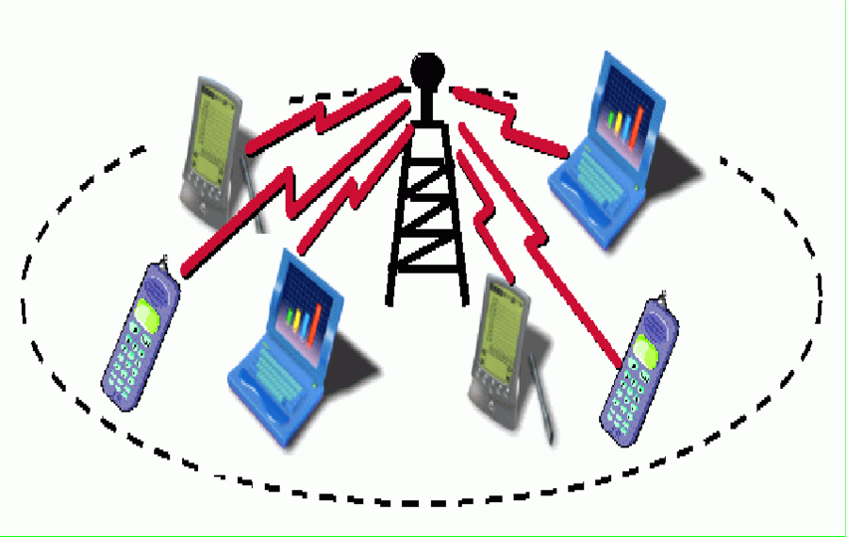
Infrastructure Based network :
Infrastructure- based network is a wireless network that requires the use of infrastructure devices such as base stations (BSs) used in traditional cellular systems or access points (APs) used in wireless local area networks (WANs) to facilitate communication between mobile devices.
Fixed infrastructure available
Must have a base station or access point
These base station or the access point are fixed and centralized
Example : WLAN, cellular network, paging system

Slide 4
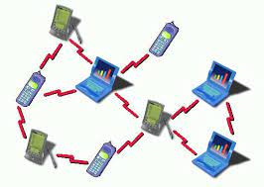
Infrastructure less network :
Infrastructure- less network is a wireless network that doesn’t requires the use of infrastructure devices such as base stations (BSs) used in traditional cellular systems or access points (APs) used in wireless local area networks (WANs) to facilitate communication between mobile devices.
So doesn’t have any base station or an access point
No existing infrastructure required
Example: Ad-hoc network(WANET)

Slide 5
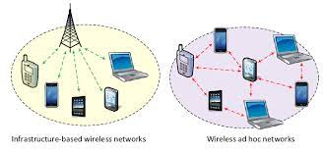
Wireless ad-hoc network :
Single hop or Multi hop network that doesn’t require any fixed infrastructure
Peer nodes take part in transmitting packets
The devices can be connected through Bluetooth, hotspot ,Zigbee…
These are temporarily established networks
These networks are useful when
need to set up network fast that is time of emergency , relief operations
no access to network infrastructure
not much planning can be afforded to setup the network
Example :
Connecting devices through Bluetooth or through hotspot comes under wireless ad-hoc (this is an example of WANET)

Slide 6
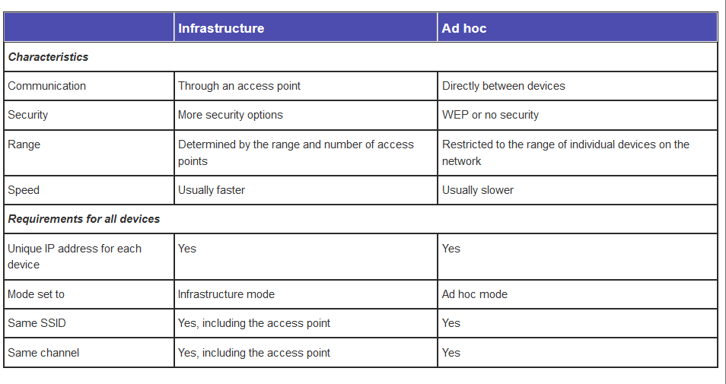
Characteristics

Slide 7
Thank you!

